Slide 1
Web Accessibility
Recognition Scheme 2015
Office of the Government Chief Information Officer
Digital Inclusion Division
24 October 2014

Slide 2
Web Accessibility Campaign
Launched in October 2011
To facilitate access to online information and services for all people of the community including persons with disabilities
To promote wider adoption of web accessibility design in both public and private websites
Video on Introduction of Web Accessibility
http://www.ogcio.gov.hk/tc/community/web_accessibility/recognition_scheme/2014/video/wars_video1.mp4

Slide 3
Web Accessibility Recognition Scheme
Objectives
Since 2013, recognise efforts and achievements in adoption of web accessibility design
Raise awareness in the community and encourage wider adoption

Slide 4
Web Accessibility Recognition Scheme
Structure
Co-organise with the Equal Opportunities Commission (EOC)
Led by an Advisory Committee comprising members from
Government and EOC
Non-profit making organisations －
Visual Impairment
Physical Impairment
Hearing Impairment
Members from ICT Industry
www.webforall.gov.hk/scheme

Slide 5
Web Accessibility Recognition Scheme
Framework
Website / Mobile Apps Streams
Gold / Silver Awards
Most Favourite Website / Mobile App Awards
Triple Gold Award ^{NEW}
Designer Award for Website / App Developers ^{NEW}
Annual Event
Open to all local enterprises & non-governmental organisations

Slide 6
Benefits of Joining the Scheme
Social Responsibility
Making websites/mobile apps accessible
Contributing to a caring and inclusive society
Recognition and Achievements
Receiving an award and building positive corporate image
Cost Savings
Familiarising of good practices and saving maintenance cost
Enhancing Competitiveness
Making websites more friendly to search engines
Widening reach-out
Corporate
Social
Responsibility

Slide 7
Benefits of Joining the Scheme
Publicity
Entitle to use award logos for promotional purposes
Invite to share experiences at public events/seminars
Publish achievements on
Interview by online media
Recognition Scheme websites, online banners
Local free / paid newspapers, magazines
Newspaper advertorials
Booklet insertion via newspaper
Radio interviews

Slide 8
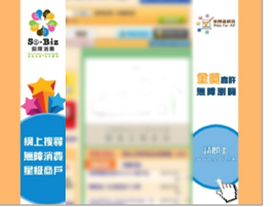
Web Accessibility Recognition Scheme
Award Logos Used for Promotional Purposes

Slide 9
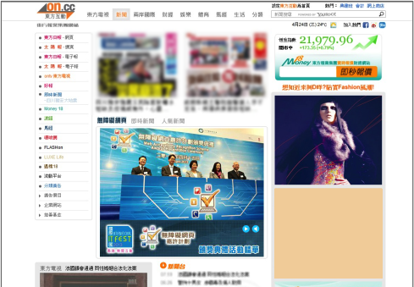
Web Accessibility Recognition Scheme
Awards Presentation Ceremony Highlights in Newspaper Website

Slide 10
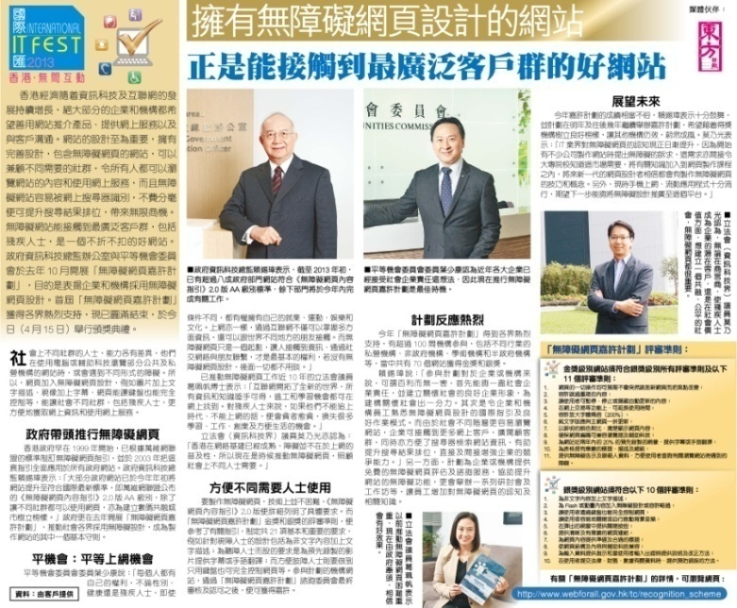
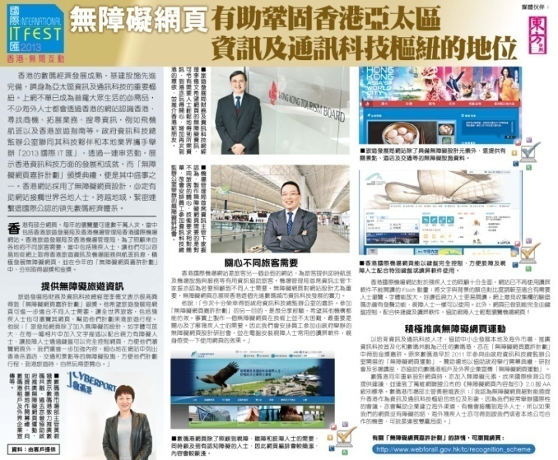
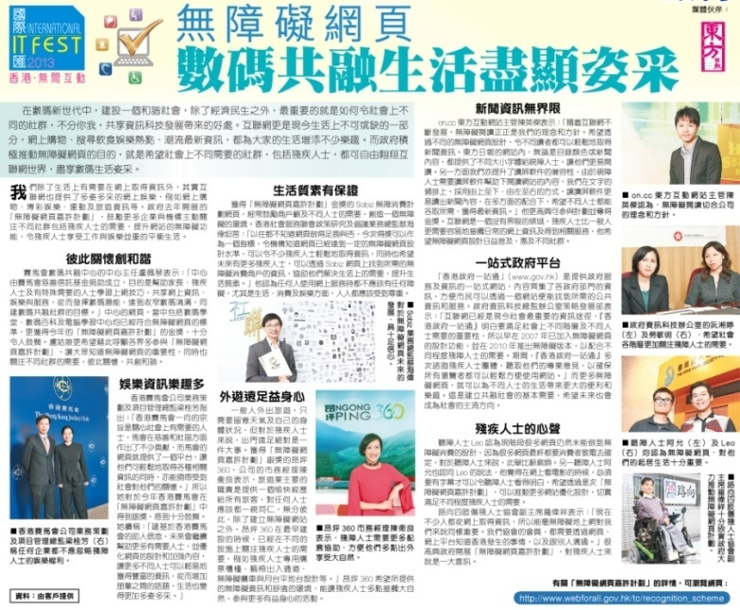
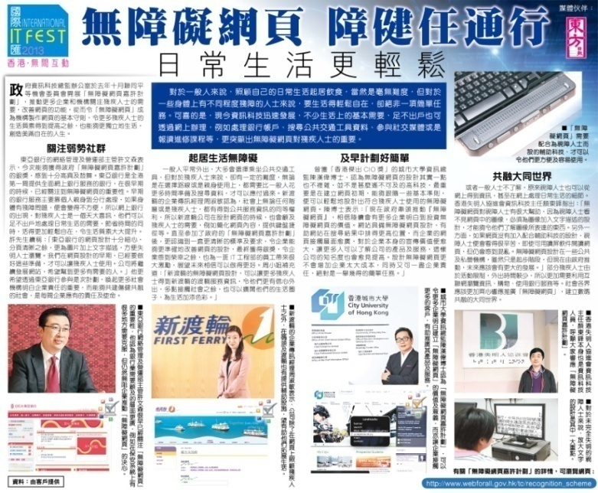
Web Accessibility Recognition Scheme
Advertorials and Booklet Insertion
via Newspaper

Slide 11
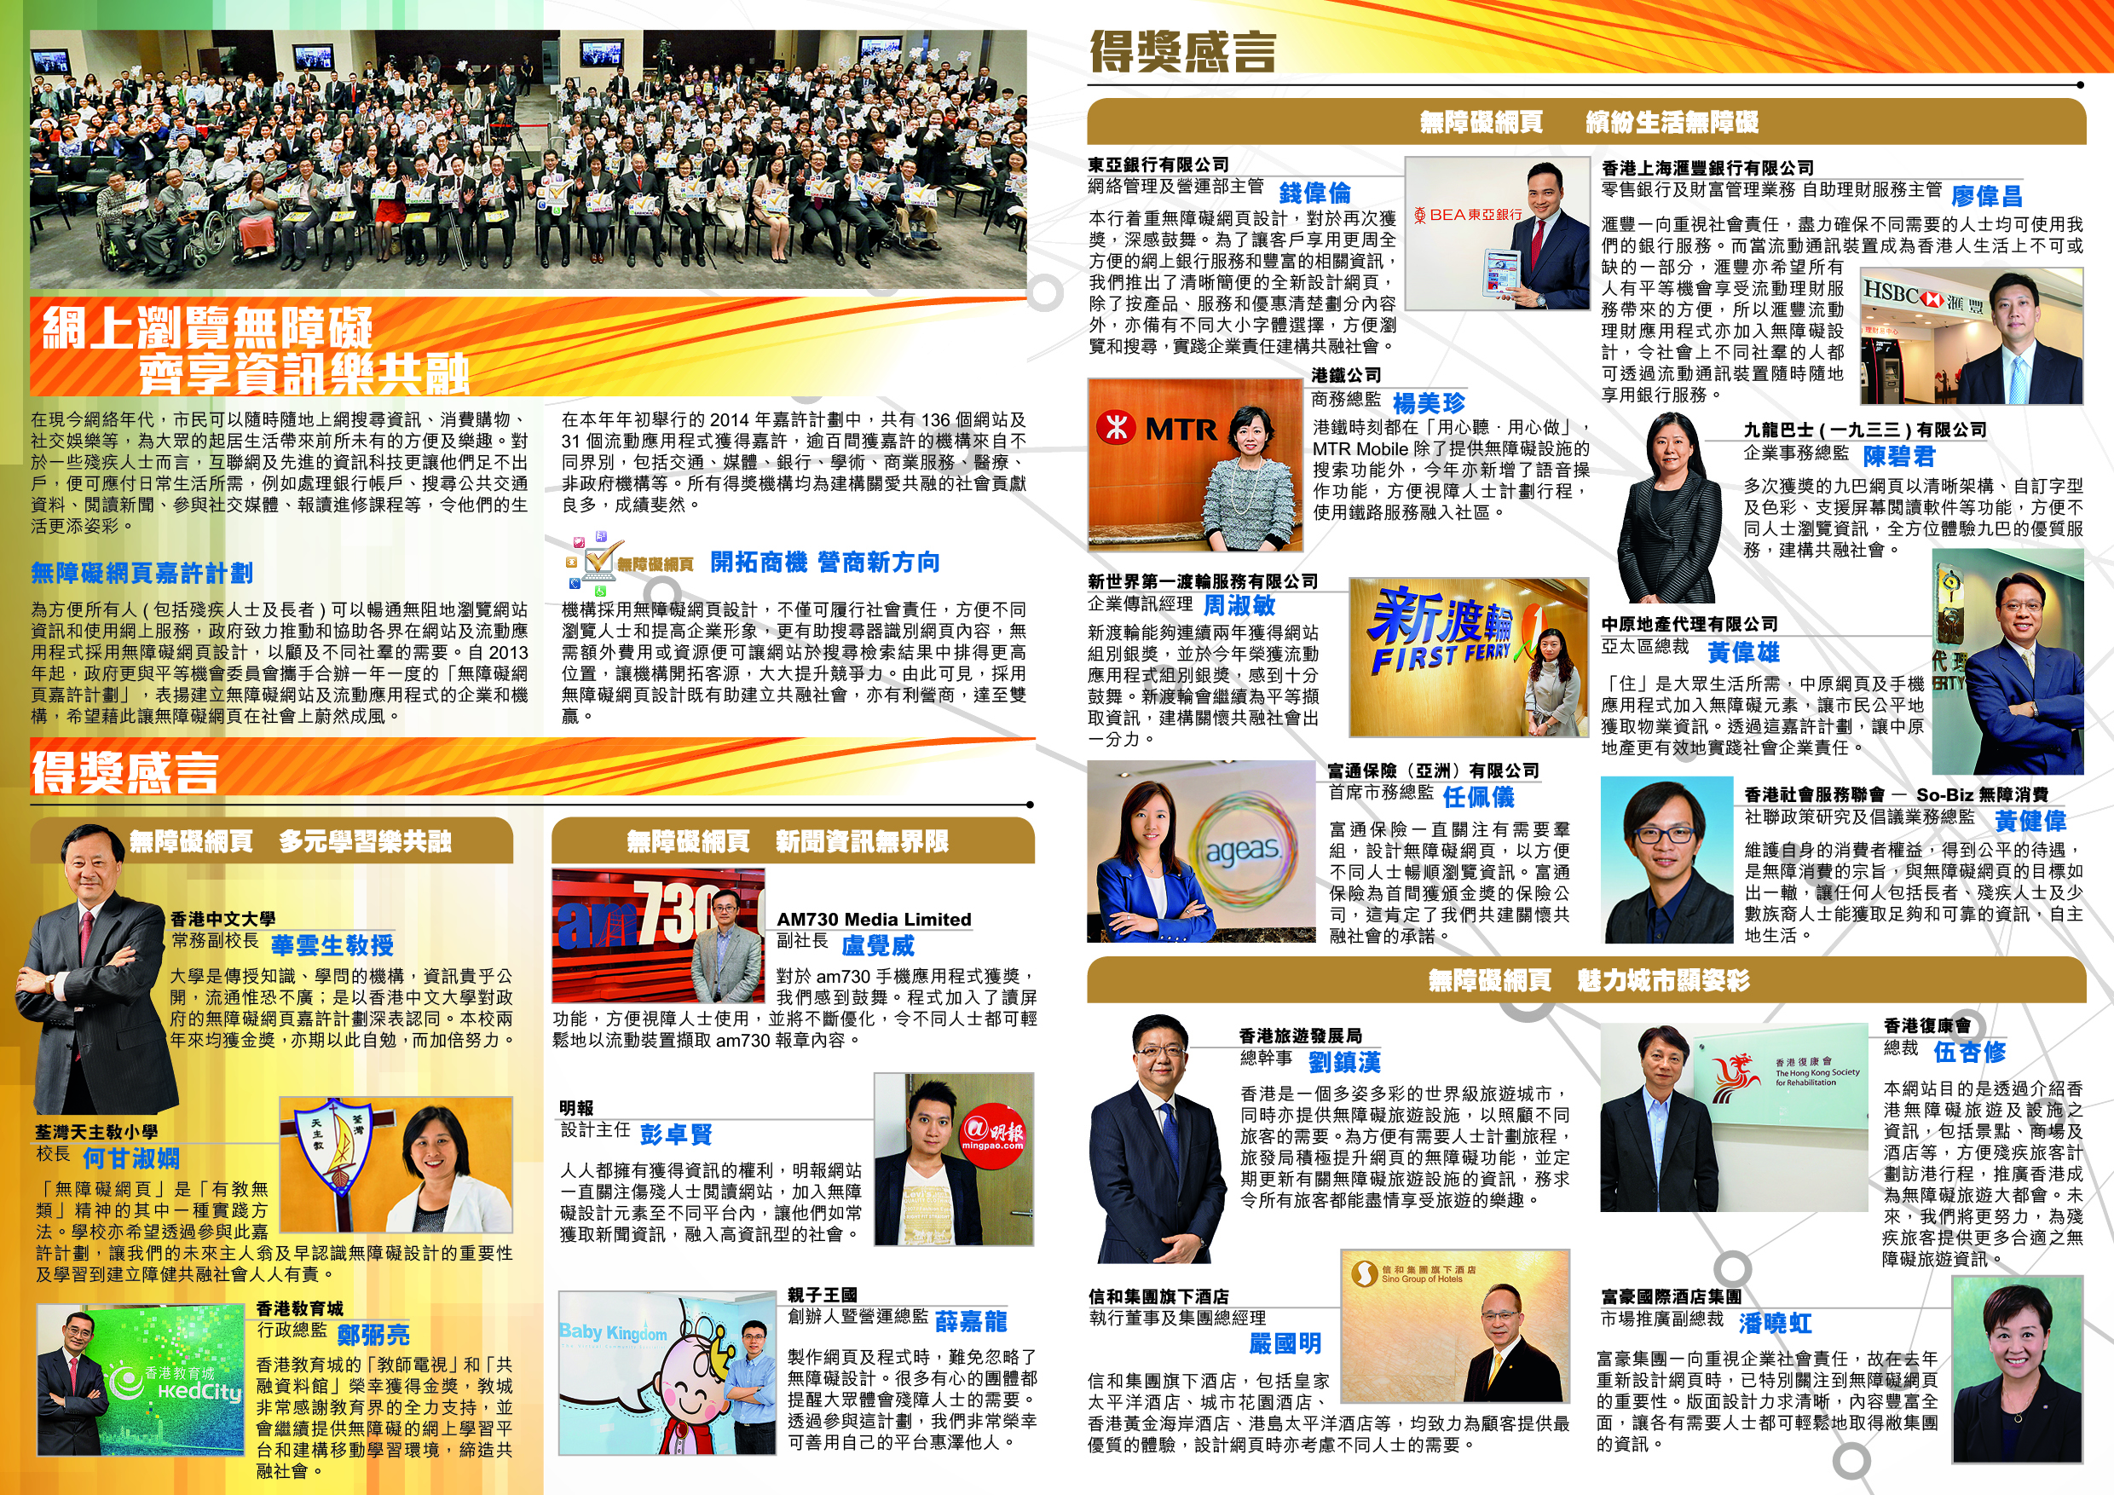
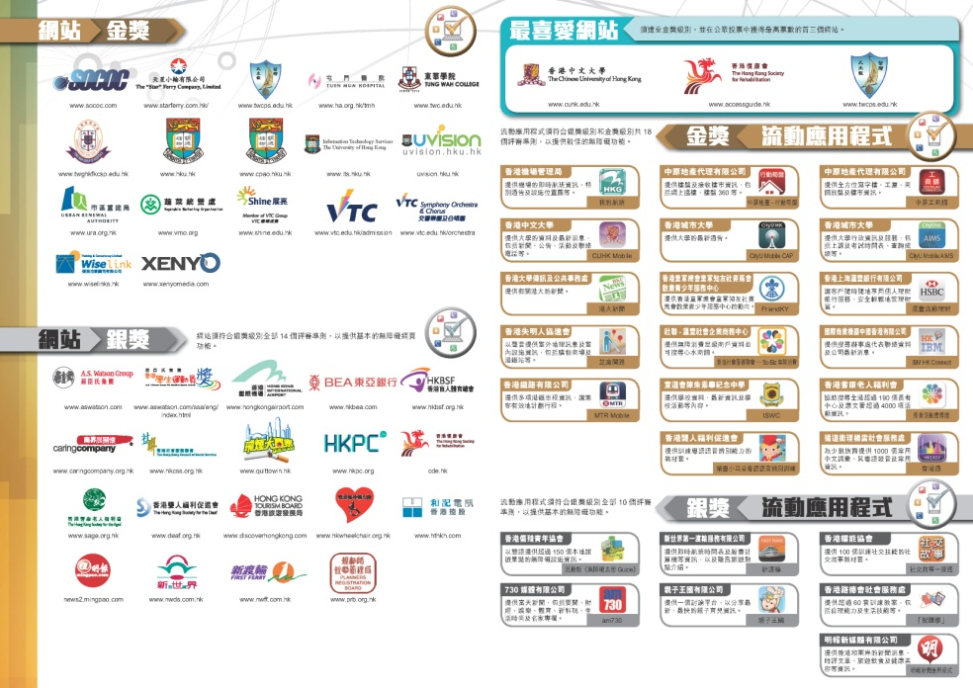
Web Accessibility Recognition Scheme
Awardees List and Advertorials in Newspapers and Magazine

Slide 12
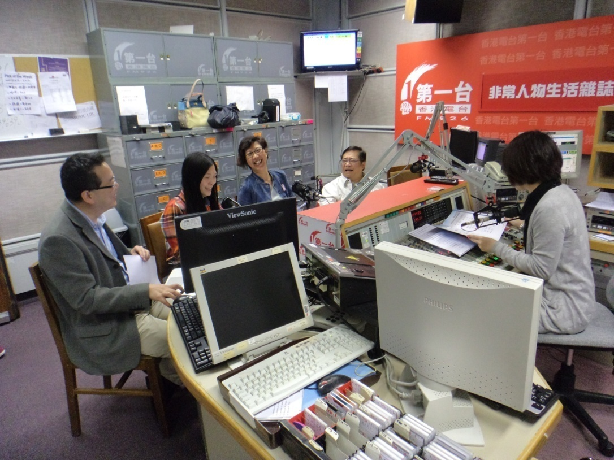
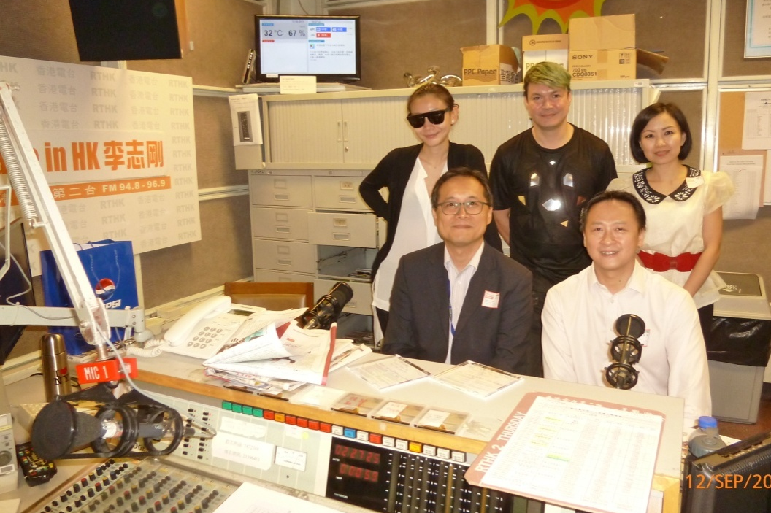
Web Accessibility Recognition Scheme
Radio Interviews

Slide 13
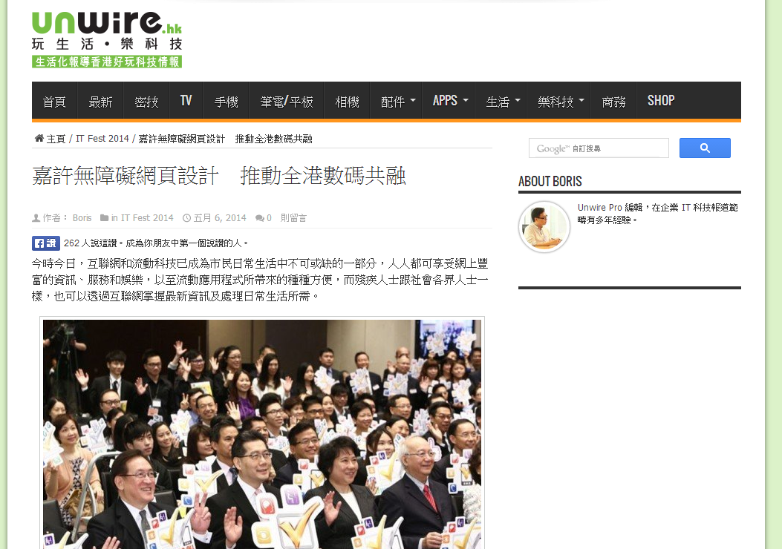
Web Accessibility Recognition Scheme
Awards Presentation Ceremony Highlight in Unwire Website

Slide 14
Web Accessibility Recognition Scheme 2014
Awards Presentation Ceremony
110
Organisations
136 Websites
31 Mobile Apps
3 Most Favourite Websites
117 Gold and 19 Silver
23 Gold and 8 Silver
Awards Presentation Ceremony of Web Accessibility Recognition Scheme 2014

Slide 15
Web Accessibility Recognition Scheme 2015
Awards
Stream | Award | No. of Judging Criteria | Accreditation Logo
Website | Silver | 14
 | Gold | 10
Mobile | Silver | 11
 | Gold | 7
New Criteria of Silver Award

Slide 16
Web Accessibility Recognition Scheme
Assessment Area – Website Stream
Main webpage
Contact Us / What’s News webpage(s)
All first-level of webpages
All webpages for
three core businesses
Mock-up website hierarchy

Slide 17
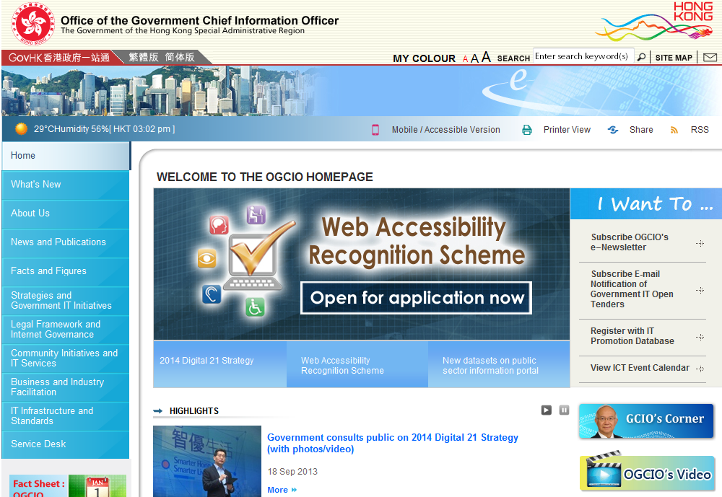
Assessment Area – Website Stream
1. Main webpage – www.ogcio.gov.hk
3. All first-level of webpages
2. Contact Us
4. Core business 1
5. Core business 2
6. Core business 3

Slide 18
Web Accessibility Recognition Scheme
Awards – Website Stream (Continue)
Triple Gold Award ^{NEW}
Attain Gold Award for 3 consecutive years
Most Favourite Websites
Attain Triple Gold Award; and
Obtain the top three number of votes in public voting

Slide 19
Judging Criteria – Website Stream (Silver)
No. | Criteria
1 | Provide meaningful text alternative for non-text contents
2 | Provide accessible Flash/Animated content or allow to skip
3 | Allow to perform all operations through a keyboard interface
4 | Easy to turn off background sound or set as user-initiated only
5 | Provide means to close popup windows
6 | Provide clear and informative links
7 | Provide accurate and appropriate headings/labels
8 | Make website content easy to be used with assistive technologies
9 | Make website structure in a consistent navigation mechanism
10 | Make website content in meaningful sequence
11 | Provide input assistance such as proper labels for user input and error identification and description etc.
12 | Provide error prevention for transactions
13 | Text can be resized up to 200 percent without loss of content
14 | Provide an accessibility statement with contact points for the website

Slide 20
Judging Criteria – Website Stream (Gold)
No. | Criteria
1 | Provide accessible PDFs
2 | Build webpages with predictable operations
3 | Able to skip repetitive blocks
4 | Provide multiple ways to retrieve content
5 | Build webpages with user-initiated auto-updating
6 | Provide sufficient time for users to read the content and operate the function
7 | Provide sufficient colour contrast
8 | Ensure correct syntax of webpages for compatibility with browsers and assistive technologies
9 | Provide captions or sign language for 30% of pre-recorded videos published in the recent 2 years
10 | Provide meaningful title, summary or description for table headers as well as data
Notes:
Applying text alternatives to images with the Alt entry in PDF documents
Ensuring correct tab and reading order in PDF documents
Using table elements for table markup in PDF Documents
Performing OCR on a scanned PDF document to provide actual text
Specifying consistent page numbering for PDF documents

Slide 21
Web Accessibility Recognition Scheme
Assessment Area – Mobile App Stream
Main screen
One-time Setup Wizard or Welcome / Settings / About Us screen(s)
All first-level screens
Three core business
functions nominated
by entrants
Screen 61
About Us
Mock-up mobile app hierarchy

Slide 22
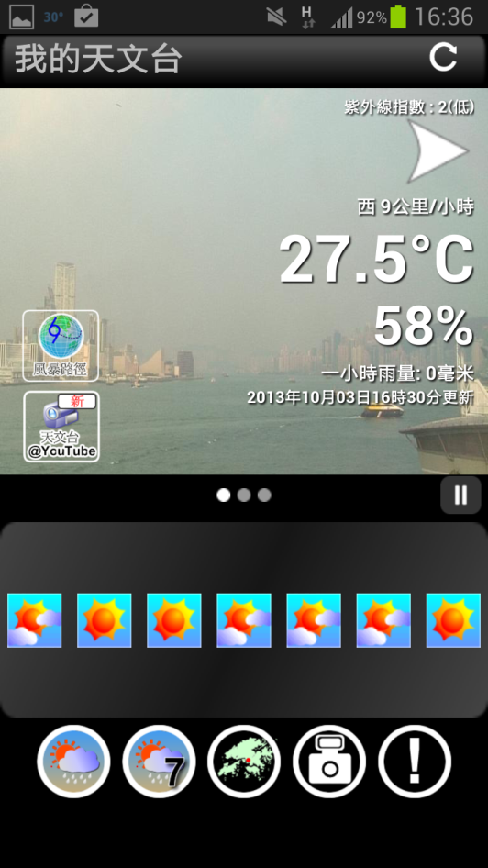
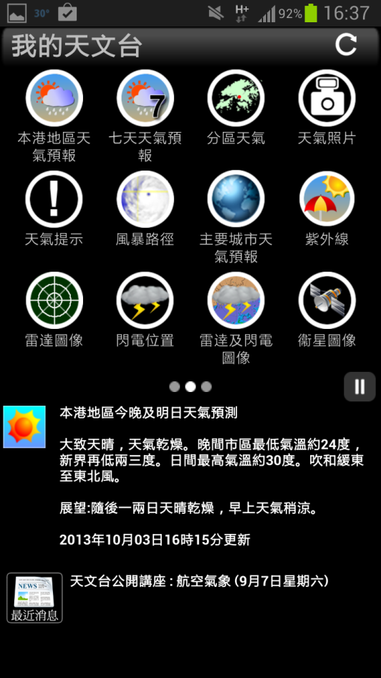
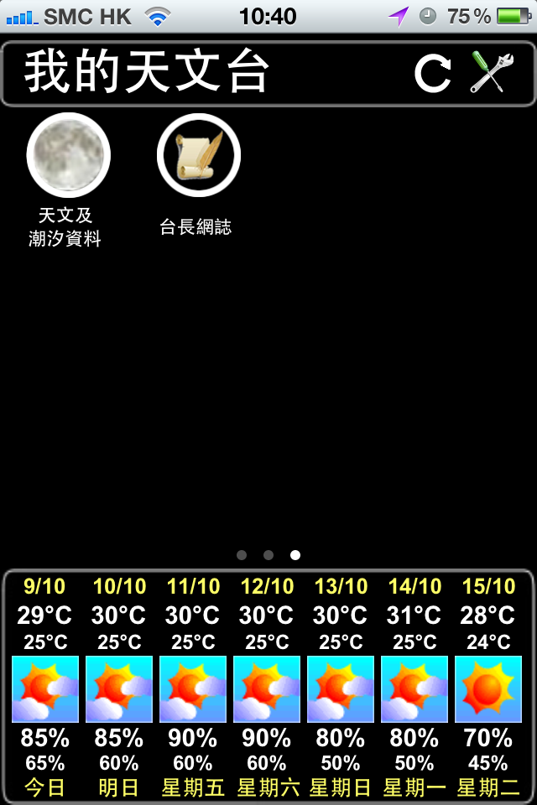
Assessment Area – Mobile Stream
Main screen – My Observatory

Slide 23
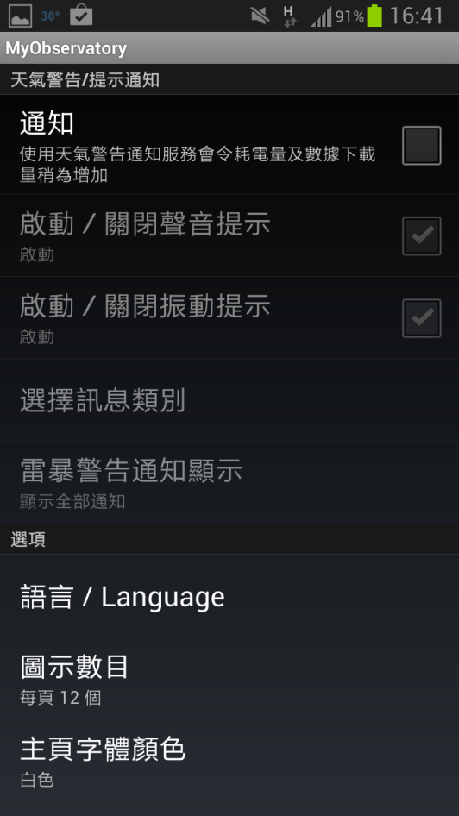
Assessment Area – Mobile Stream
Main screen – My Observatory
4. Core business 1
5. Core business 2
2. Settings
3. All first-level screens
6. Core business 3

Slide 24
Web Accessibility Recognition Scheme
Awards – Mobile App Stream (Continue)
Most Favourite Mobile App
Attain Gold Award; and
Obtain the top three number of votes in public voting

Slide 25
Judging Criteria – Mobile Application Stream (Silver)
No. | Criteria
1 | Provide meaningful text alternative for non-text contents
2 | Easy to turn off background sound or set as user-initiated only
3 | Make all clickable objects large enough to be tapped
4 | Provide clear and simple headings
5 | Provide consistent and simple user interface structure
6 | Provide meaningful content sequence
7 | Provide navigation for going backward
8 | Provide clear and informative links
9 | Text resize function or text can be zoomed without loss of content
10 | Compatible with screen readers
11 | Provide contact points or “email feedback” feature #
# gold criterion last year

Slide 26
Judging Criteria – Mobile App Stream (Gold)
No. | Criteria
1 | Provide sufficient colour contrast
2 | Provide sufficient time for users to read the content and operate the function
3 | Provide captions or sign language for 30% of pre-recorded videos published in the recent 2 years
4 | Provide alternative means for notification
5 | Provide input assistance such as proper labels or instructions for user input
6 | Provide error prevention for transactions
7 | Provide means to close popovers

Slide 27
Web Accessibility Recognition Scheme
Timeline
Stage | Key Tasks | Period
1. | Application | Now until 31 December 2014
2. | Assessment and Enhancement | Now until 30 January 2015
3. | Technical Workshops | 3 November 2014 – 30 January 2015
4. | Re-assessment | 2 January 2015 – 20 February 2015
5. | Voting for Most Favourite Websites / Mobile App Awards | 2 March 2015 – 23 March 2015
6. | Awards Presentation | April 2015

Slide 28
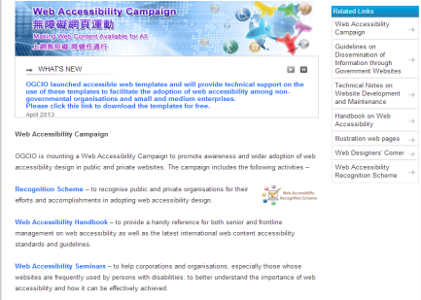
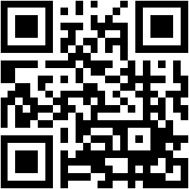
Web Accessibility Recognition Scheme
Useful Reference
www.webforall.gov.hk
Webforall Portal
Live-examples of success criteria (WCAG 2.0 Level AA)
Presentation slides of seminars / technical workshops
Web Designers’ Corner
facilitating the sourcing of ICT professional services
Legal cases

Slide 29
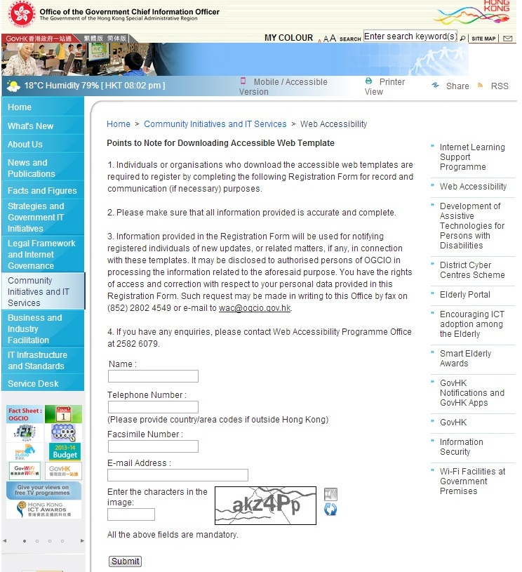
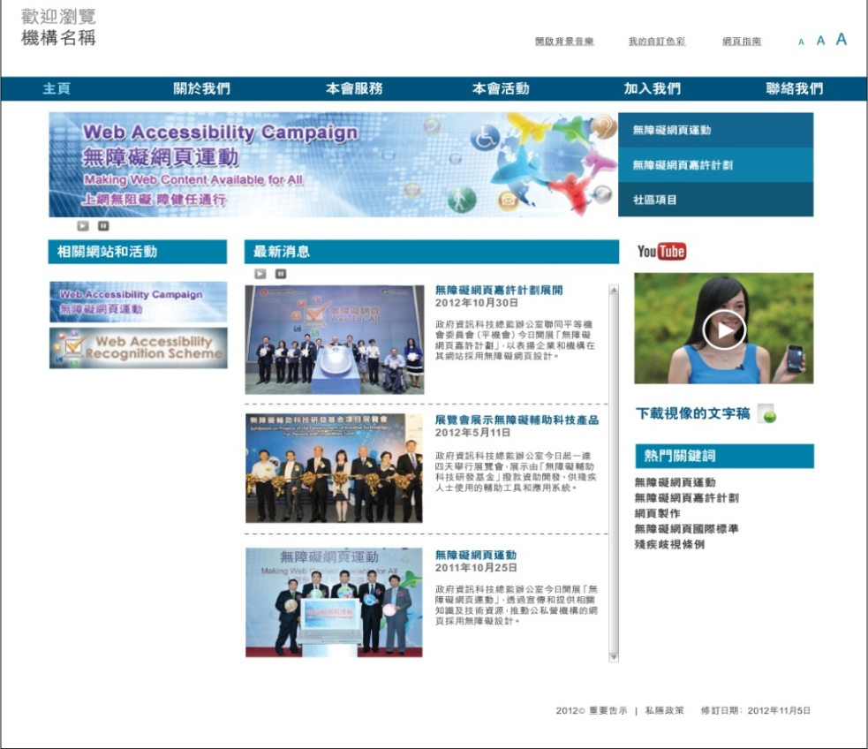
Web Accessibility Recognition Scheme
Useful Reference
Accessible Webpage Templates
Free Download - www.webforall.gov.hk/web_template.htm

Slide 30
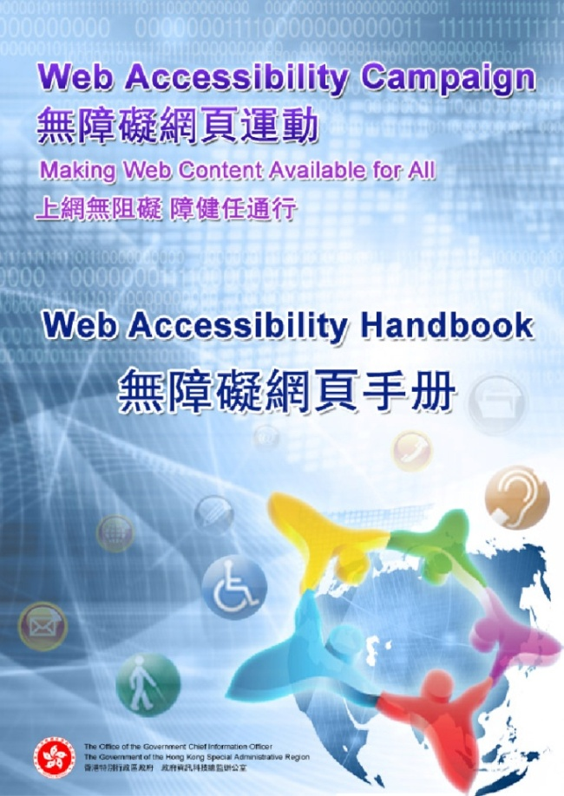
Web Accessibility Recognition Scheme
Useful Reference
Web Accessibility Handbook
Designed for senior executives and management
Introduce WCAG 2.0 and success criteria
Web Accessibility Concept
How Persons with Disabilities use Websites
Illustration of Each Criterion
Testing Strategy
Useful Reference
www.webforall.gov.hk/en/wahandbook

Slide 31
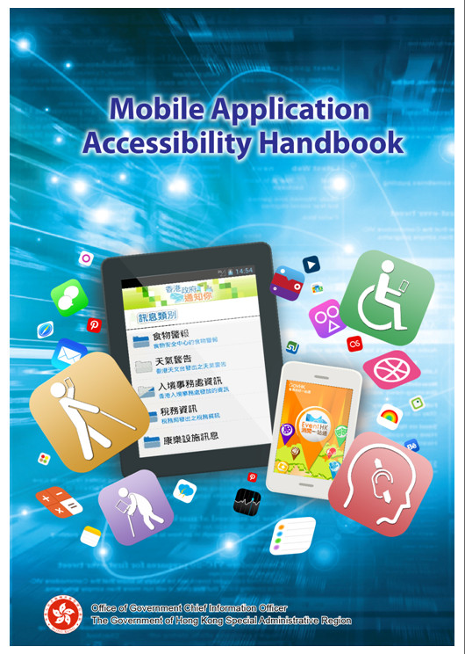
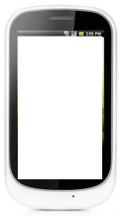
Web Accessibility Recognition Scheme
Useful Reference
Mobile Application
Accessibility Handbook
Designed for mobile app owners and developers
Based on the WCAG 2.0 and feedbacks collected from local disability groups
Basic Concept
Best Practices
Checklist for Developers
Testing Strategy
Useful Reference
APPS
www.webforall.gov.hk/en/maahandbook

Slide 32
Web Accessibility Recognition Scheme
Technical Workshop
Venue: Office of the Government Chief Information Officer
Conference Room, 15/F Wanchai Tower,
12 Harbour Road, Wanchai, Hong Kong
Please contact Ms Windy Chan at 2582 6079 to register
Workshop | Date | Time
1 | 5 November 2014 (Wednesday) | 2:30 – 4:00 pm
2 | 12 November 2014 (Wednesday) | 10:00 – 11:30 am
3 | 20 November 2014 (Thursday) | 10:00 – 11:30 am
More details, please refer to http://www.ogcio.gov.hk/en/community/web_accessibility/recognition_scheme/technical_workshop/

Slide 33
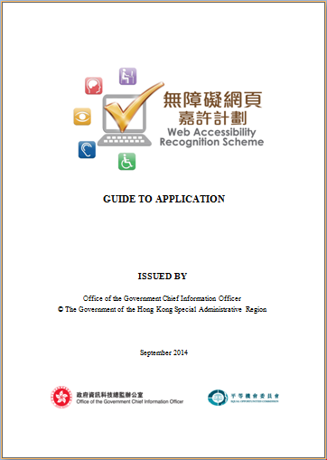
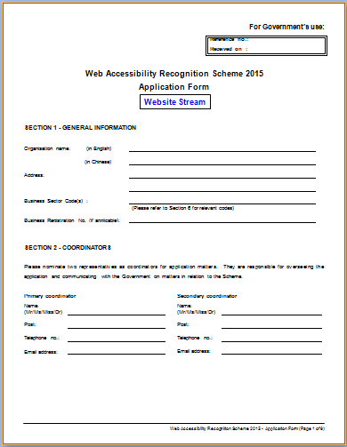
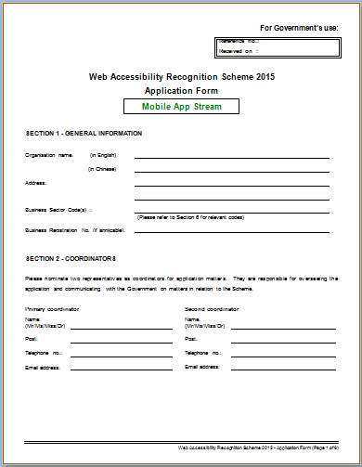
Web Accessibility Recognition Scheme
Enrol Now!
www.webforall.gov.hk/en/scheme

Slide 34
Web Accessibility Recognition Scheme
Common Q&As
Application-related
Q1 : Can an organisation submit more than one application?
A1 : Yes. Main homepage, thematic websites, mobile apps are welcome, please use individual form.
Q2 : Do 2014 Entrants need to submit application form again?
A2 : Yes.

Slide 35
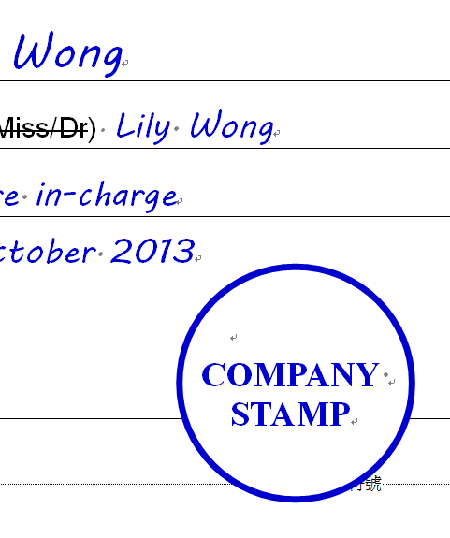
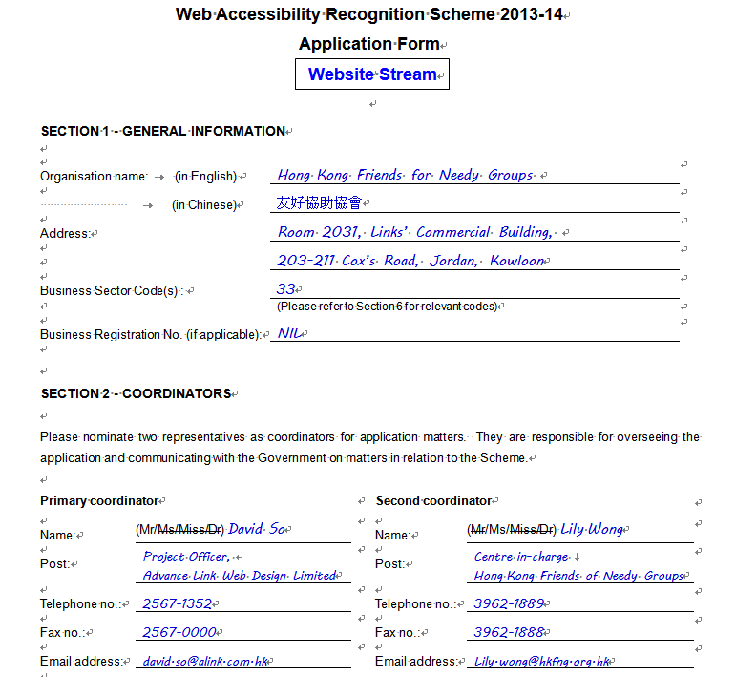
Web Accessibility Recognition Scheme
Application-related
Q3 : Can I nominate other organisation to apply?
A3 : Yes but ensure the organisation name should be the entrant and the organisation chop is stamped.
Can be norminator
Organisation information

Slide 36
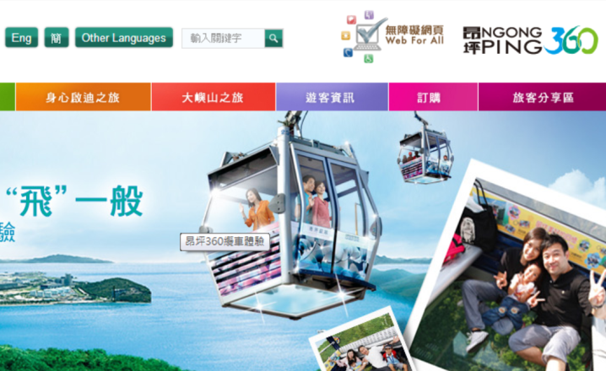
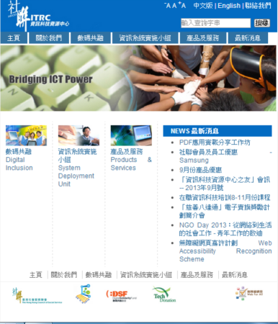
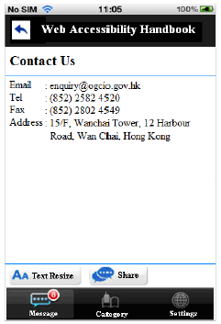
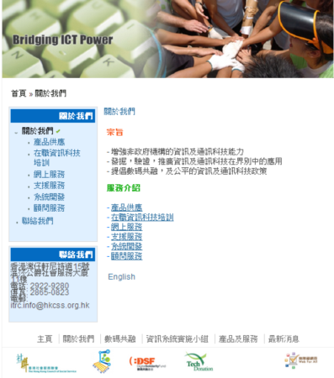
Web Accessibility Recognition Scheme
Award-related
Q4 : Is there any requirement on where to display the award logo?
A4: Awarded organisations may display the Award Logo on -
front-page, first screen, contact us screen, app icon;
those entitled webpages, screens;
marketing items (e.g. name card, letterhead and envelope…)
promotional materials (e.g. leaflet, poster, advertisement...)

Slide 37
Web Accessibility Recognition Scheme
Highlights of Awards Presentation Ceremony of the Web Accessibility Recognition Scheme 2014
www.ogcio.gov.hk/en/community/web_accessibility/recognition_scheme/2014/video/wars_video3.mp4

Slide 38
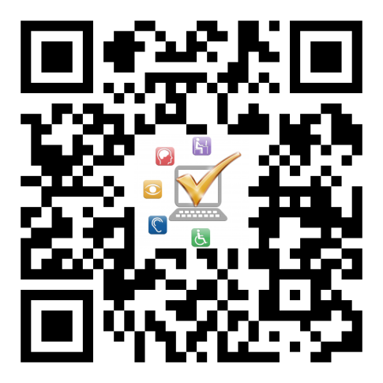
Thank you!
Web Accessibility Campaign Programme Office
Email : wac@ogcio.gov.hk
Tel. no. : 2582 4606
Web Accessibility Campaign
www.webforall.gov.hk
Web Accessibility Recognition Scheme
www.webforall.gov.hk/scheme

